Slide 1
CUSTOMER CHURN PREDICTION USING LOGISTIC REGRESSION, DECISION TREE AND RANDOM FOREST IN R PROGRAMMING

Slide 2
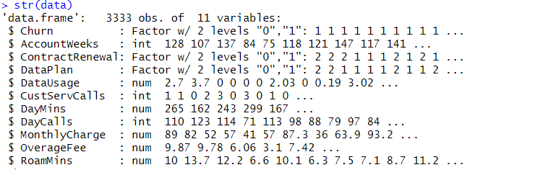
DATASET
Read the dataset and check the data types
There are 3333 rows and 11 columns
Data cleaning
Check for missing values. None are found
Check the data types of each variable
Categorical vectors need to be converted to factor vector as it is a classification problem. Churn is the dependent variable

Slide 3
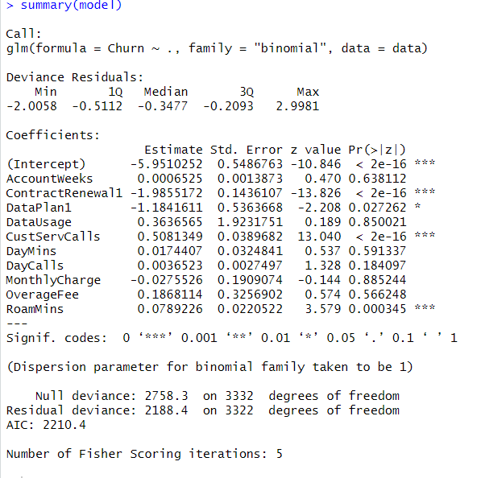
LOGISTIC REGRESSION
Run logistic regression

Slide 4
LOGISTIC REGRESSION
Used the stepwise function which will include all the independent variables and start removing the insignificant variables one after the other
Variables that has been removed are "AccountWeek" , "DayCalls", "DataUsage", "MonthlyCharge“
Checked for multicollinearity in the model by using the VIF function but found none as the absolute values are less than 5
Split the data into train and test (80/20) by using createDataPartition function
Use the train data to create the model and the test data for prediction

Slide 5
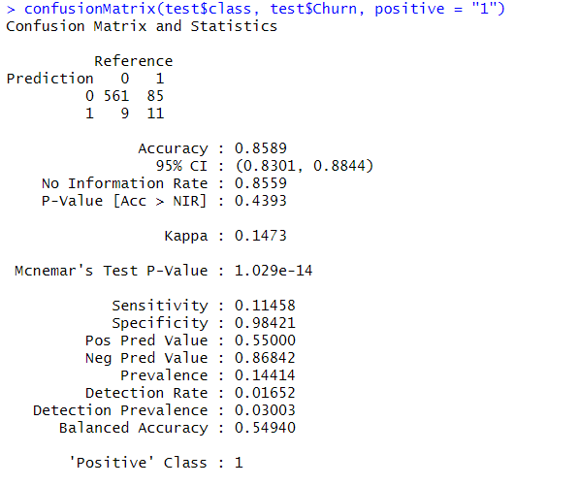
LOGISTIC REGRESSION
Use confusion Matrix to find out the sensitivity , specificity and accuracy of the model.
Accuracy = 85.89% (prediction of both churners and non churners), Sensitivity = 11.45% (prediction of churners out of the total number of churners), Specificity = 98.42% (prediction of non churners out of the total number of non churners)

Slide 6
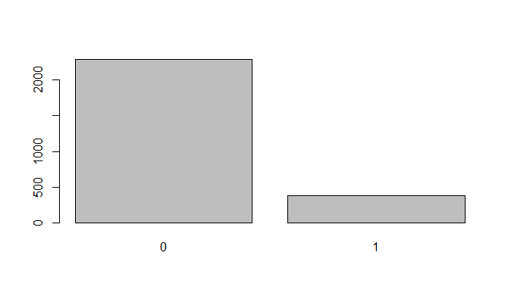
LOGISTIC REGRESSION
Sensitivity or True Positive rate is important as we want to predict the total number of churners.
In the dependent variable Churn, there are 2 levels of observations (1 = churners and 0 = non churners)
A lower sensitivity rate (11.45% in this case) can sometimes be due to imbalanced data
It is clearly visible that there are significantly more non churners (2280 nos) in the dataset as opposed to churners (387 nos)

Slide 7
LOGISTIC REGRESSION
We will use the function “ovun.sample” from package “ROSE” to balance the data by oversampling, undersampling and both sampling
Observations: 2280*2 = 4560 for oversampling, 387*2 = 774 for undersampling & (4560+774)/2 = 2667 for both sampling
Ovesampling data is stored in over_data , undersampling data in under_data, both sampling data in both_data.
Confusion matrix provides us the Accuracy (79.13%), Sensitivity (75%) and Specificity (79.82%) for oversampling in Logistic Regression
Confusion matrix provides us the Accuracy (79.13%), Sensitivity (72.92%) and Specificity (80.18%) for under sampling in Logistic Regression
Confusion matrix provides us the Accuracy (79.13%), Sensitivity (75%) and Specificity (79.82%) for both sampling in Logistic Regression

Slide 8
DECISION TREE
We will use Decision Tree for prediction of all three types of data i.e oversampling, under sampling and both
We will use the library(“rpart”) for this purpose
Confusion matrix provides us the Accuracy (87.84%), Sensitivity (82.29%) and Specificity (88.77%) for oversampling in Decision Tree
Confusion matrix provides us the Accuracy (90.24%), Sensitivity (83.33%) and Specificity (91.40%) for under sampling in Decision Tree
Confusion matrix provides us the Accuracy (87.84%), Sensitivity (84.38%) and Specificity (88.42%) for both sampling in Decision Tree

Slide 9
RANDOM FOREST
We will use Random Forest for prediction of all three types of data i.e oversampling, under sampling and both
We will use the library(“randomForest”) for this purpose
Confusion matrix provides us the Accuracy (93.09%), Sensitivity (66.67%) and Specificity (97.54%) for oversampling in Random Forest
Confusion matrix provides us the Accuracy (88.74%), Sensitivity (81.25%) and Specificity (90%) for under sampling in Random Forest
Confusion matrix provides us the Accuracy (92.79%), Sensitivity (72.92%) and Specificity (96.14%) for both sampling in Random Forest

Slide 10
ROC AND AUC
We have a ROC (Receiver Operating Characteristics) curve to measure the accuracy of a classification prediction. ROC Curve is formed by plotting Sensitivity and Specificity. The AUC (Area under Curve) of this ROC curve helps us to determine the specificity and sensitivity of the model at different points. THe higher the AUC, the better the model’s performance at distinguishing between the CHURNERS and NON CHURNERS.
We use library(pROC) and “roc” function to find out the AUC for oversampling data, undersampling data and both sampling data across Logistic Regression, Decision Tree and Random Forest

Slide 11
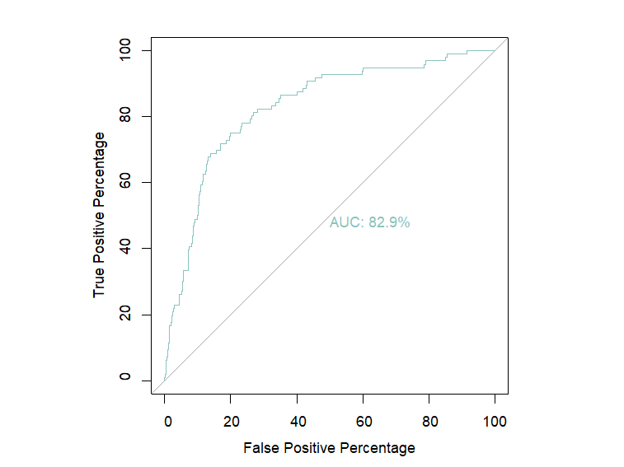
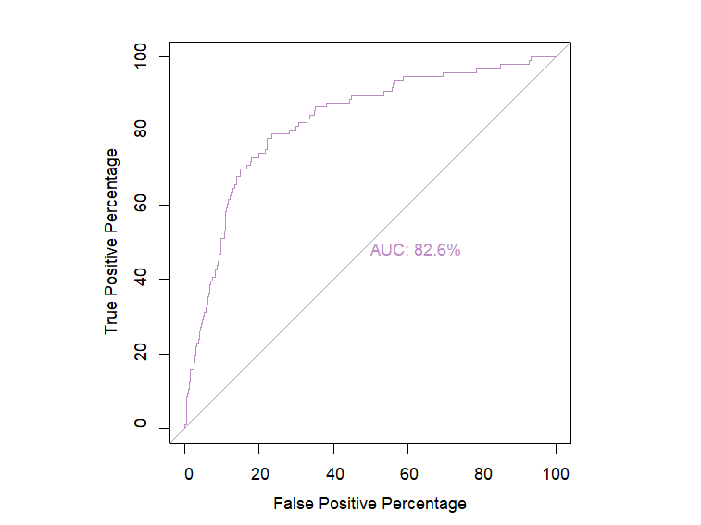
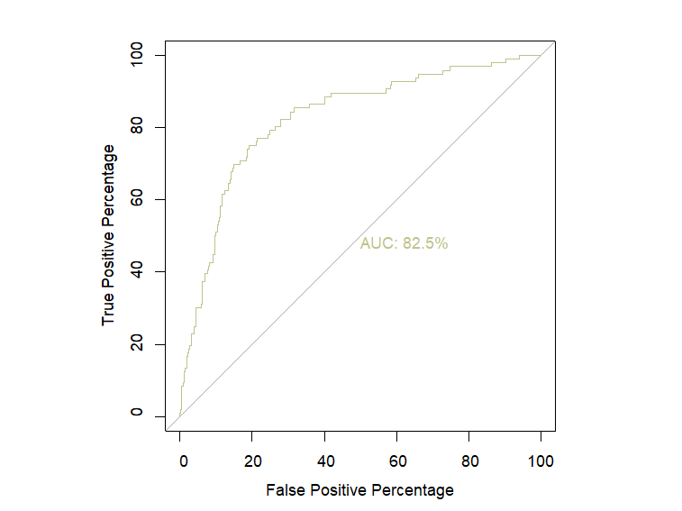
AUC OF LOGISTIC REGRESSION
oversampling
undersampling
both sampling

Slide 12
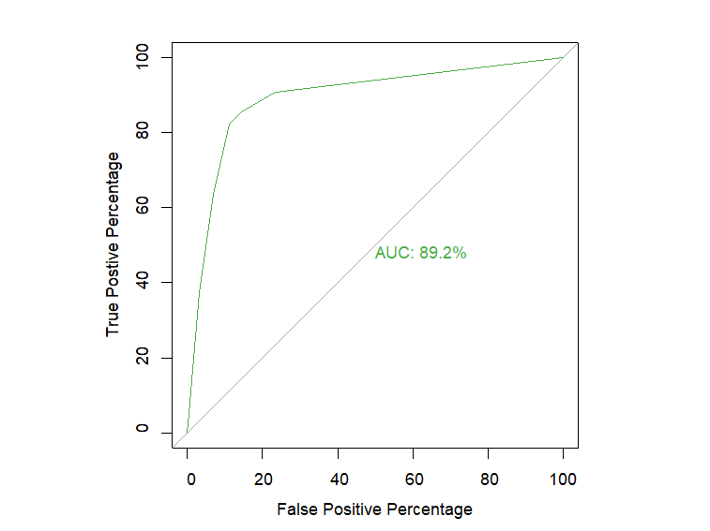
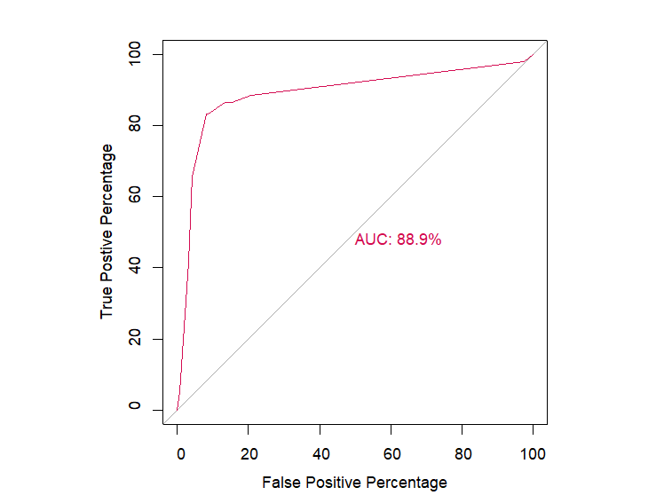
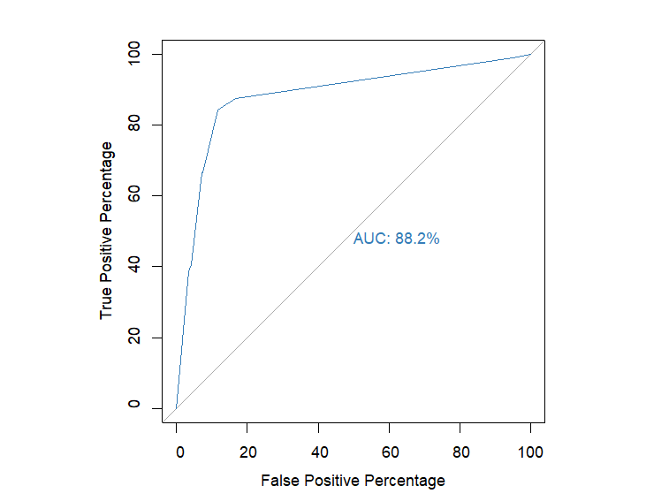
AUC OF DECISION TREE
oversampling
under sampling
both sampling

Slide 13
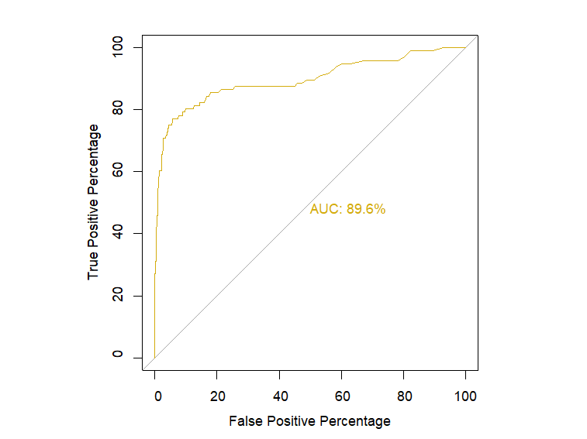
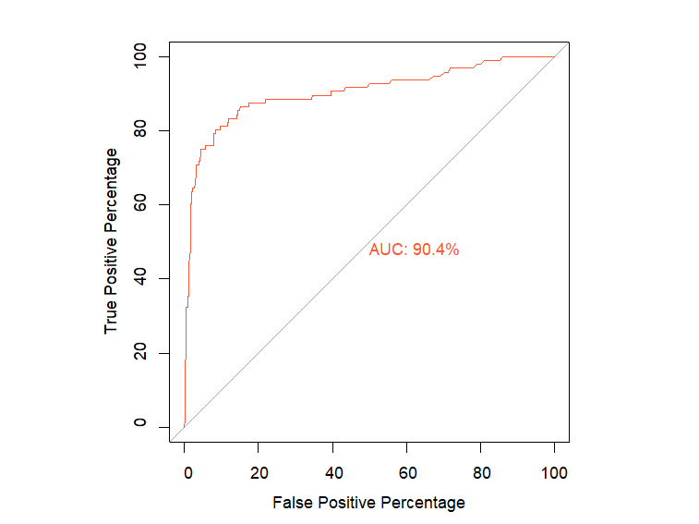
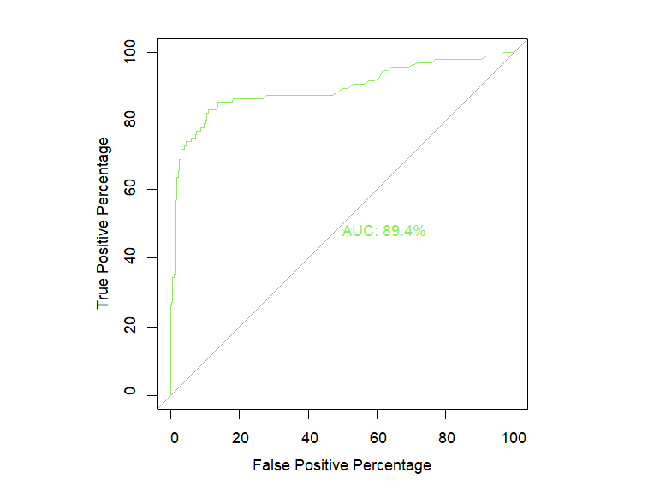
AUC OF RANDOM FOREST
oversampling
under sampling
both sampling

Slide 14
CONCLUSION
As our main objective is to choose a model which could predict the churners, we can look at the results of sensitivity for oversampling , under sampling and both. If we opt for confusion Matrix, then Decision Tree is the best model for all the three types of data
Confusion Matrix provides us the true positive rate only at one cut off point , whereas in ROC and AUC we are mapping the true positive rate at different cut off points. If we opt for AUC, then Random Forest is the best model.
 | SENSITIVITY
 | Oversampling | Under sampling | Both
Logistic Regression | 75.00% | 72.92% | 75.00%
Decision Tree | 82.29% | 83.33% | 84.38%
Random Forest | 66.67% | 81.25% | 72.92%
 | AUC
 | Oversampling | Under sampling | Both
Logistic Regression | 82.90% | 82.60% | 82.50%
Decision Tree | 89.20% | 88.90% | 88.20%
Random Forest | 89.60% | 90.40% | 89.40%

